Slide 1

GenEmoji
Converting Natural Language to Emoji Compositions via DRL, GA, and Fuzzy Logic
Ç
Computational Intelligence – Deep Reinforcement Learning
Papadopoulos Panagiotis 10697

Slide 2


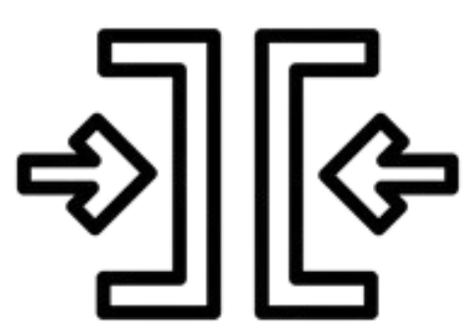
The Challenge: Language to Emojis
How can we generate a semantically accurate image using only emoji symbols, based on a natural language prompt that includes descriptive and spatial elements?
Objective
Transform user input like:
“A slightly angry penguin holds ice and wears a monocle”
into a structured emoji composition placed on a visual canvas.
Constraints
No text or real images allowed
All symbols must be selected and arranged to reflect prompt semantics

Slide 3

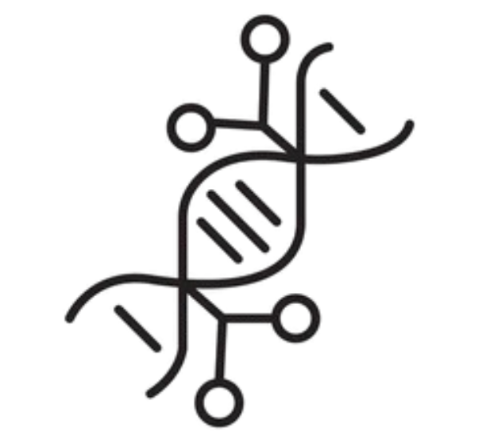

Three Core Components
Fuzzy Logic
Genetic Algorithm
Deep Reinforcement Learning
Understand the Prompt
Selects optimal emoji combination
Arranges emojis on a canvas
Identifies keywords from user input
Each chromosome = 4 emojis
Fitness based on:
Evolves over 20 generations with mutation
PPO agent places emojis step by step
Action space = emoji index, position, size, layer, etc.
Learns to create semantically correct, visually clean images
Assigns fuzzy scores (e.g. “slightly angry” → 0.3)
Fuzzy similarity to prompt
Coverage, diversity, redundancy penalties
Distinguishes between roles: core, modifier,
accessory, background

Slide 4



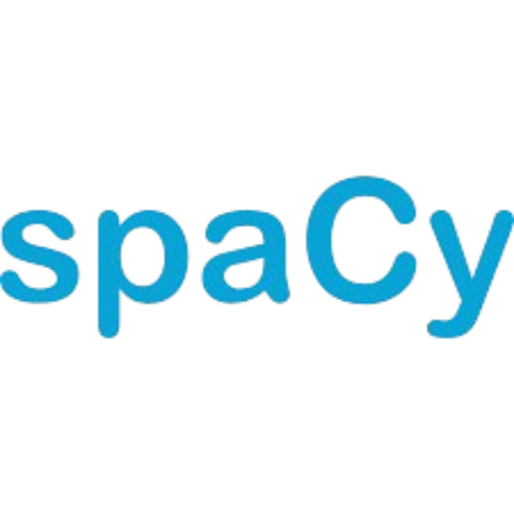

Extracting Structure from Natural Language
Syntactic Analysis
Role Map Generation
Prompt is parsed with to extract valid keywords
Focus only on keywords present in the emoji dataset
Linguistic roles are identified based on grammar:
Each keyword is assigned to:
Core → main subject (e.g., “penguin”)
Modifier → emotional or descriptive (e.g., “angry”)
Accessory → objects (e.g., “ice”, “monocle”)
Background → detected from prepositions (e.g., “in the mountains”)
Subject → core
Adjectives/Adverbs → modifiers
Objects → accessories
This hierarchical role map ensures that the semantic weight of each concept is respected during emoji selection and placement.

Slide 5


Modeling Semantic Intensity with Fuzzy Logic
Fuzzy Adverb Interpretation
Score Calculation
Fuzzy modifiers convert language intensity to numeric scores:
Final fuzzy score per keyword:
Role weights:
fuzzy_score = adverb_modifier × role_weight
“slightly angry” → 0.3
“absoslutely angry” → 1.0
“not very angry” → 0.2
Core: 1.0
Modifier: 0.9
Accessory: 0.4
Background: 0.5
Fuzzy Logic Output:
Fuzzy Vector → numerical representation of prompt semantics
This vector becomes the fitness target for the genetic algorithm
Fuzzy logic bridges natural language and numerical optimization — enabling vague user intent to guide emoji selection meaningfully.

Slide 6
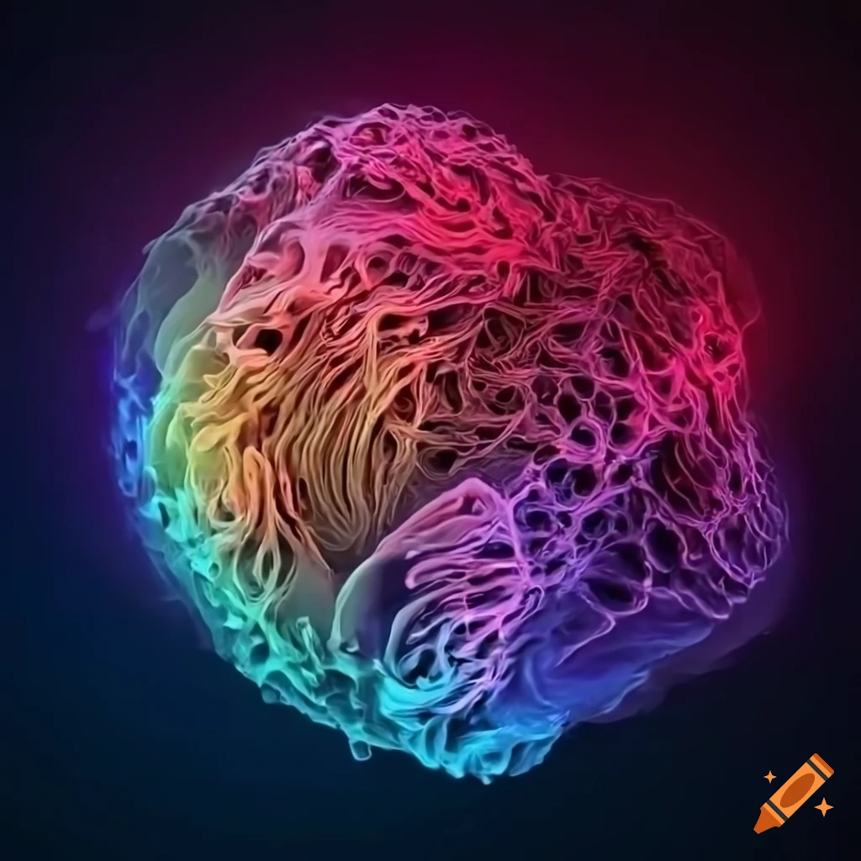


Genetic Algorithm: Selecting the Right Emojis
Chromosome Representation
Fitness Function Design
Each individual = 1 chromosome = 4 emoji symbols
Each gene is an emoji drawn from the full dataset
The population evolves toward better semantic alignment with the prompt
Rewarded:
Penalized:
Fuzzy similarity with target vector
Keyword coverage
Emoji diversity (unique symbols)
Strong matches (≥ 80% of target)
Semantic overlaps (e.g., “cold” vs. “ice”)
The fitness function captures both linguistic alignment and emoji efficiency.
Redundant keyword overlap
Irrelevant/noise emojis (not in prompt)

Slide 7
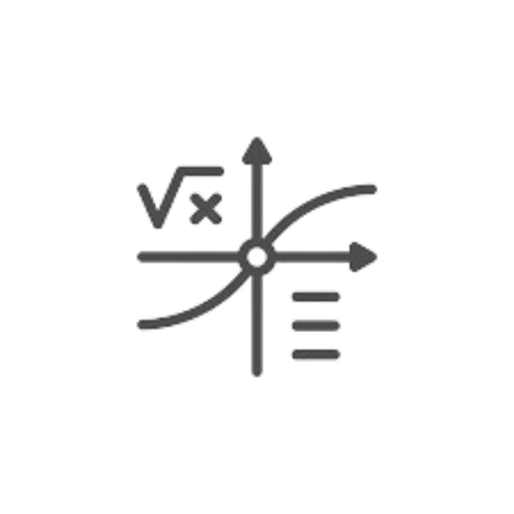

Optimization of the GA
Weighted Formula (Final)
Evolution Process
score = (
0.5 × fuzzy_similarity + 0.15 × strong_bonus +
0.15 × coverage_ratio +
0.1 × diversity +
0.1 × efficiency +
relevance_bonus ) − 0.1 × redundancy − 0.1 × noise
Population size: 450
Generations: 20
Selection: Random 2 from top 5 in generation (partial tournament)
Elitism: Best 2 survive unchanged
Mutation:
Improves search space exploration and diversity
Allows better convergence over time
1 gene mutated randomly
Adaptive mutation rate: max(0.3, 0.9 − 0.05 × generation)
Encourages exploration early, stability later
Parameter tuning increased population diversity and evolutionary depth,
_while reward restructuring improved semantic focus and discouraged noise.

Slide 8


Performance of the GA
Evaluation Example
Observations
Prompt: “An angry penguin holds ice and wears a monocle”
Target vector: → { penguin: 1.0, angry: 0.9, ice: 0.4, monocle: 0.4 }
Top chromosomes: [🈂, 😠, 🧊, ⏏], [👿, 🐧, 🍧, サ], [💪, 🐧, 🤬, 🍧]
Fuzzy similarity and keyword coverage improve over time
Initial results had noise (🈂, サ)
Later chromosomes consistently include:
Monocle is often missed → rare in dataset or weakly linked
🐧 → penguin
🤬/😠/👿 → angry
🍧/🧊 → ice
The GA achieved consistent alignment with 3 out of 4 target concepts. Rare keywords remained ___underrepresented due to dataset sparsity and ______search bias.

Slide 9
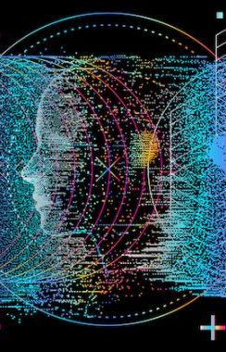



Arranging Emojis with Deep Reinforcement Learning
Overview of the Task
Objective: Compose a meaningful image using selected emojis
Agent learns:
The goal is to reflect the semantic + spatial intent of the prompt
Where to place each emoji
What size, layer, crop, and color to apply
Ç
Environment:EmojiCompositionEnv
Built using
Canvas: 256×256 RGB image
Max steps: 10 (1 emoji placement per step, agent may stop earlier)
Observation space: canvas image
Action space (8D continuous vector): [emoji_index, x, y, size, layer, crop_type, color_ref, stop_flag]

Slide 10


Training Agents & Designing the Reward Function
Reward Design Summary
Architectures Tested
✔ Core emoji placement: center, medium size, layer = 1
✔ Accessory placement: near core, small, layer = 2
✔ Background: large, layer = 0
✔ Early stop if composition is clean
✔ Color bonus defined in reward function, but not triggered in current implementation
✖ Penalties for:
All agents trained from scratch using PPO with ent_coef=0.1 and CPU only:
mlp_32x2 – Lightweight baseline
mlp_64x2 – Intermediate
mlp_128x1 – Balanced, best performance
mlp_128x2 – More stable, slower to converge
mlp_256x2 – High capacity, prone to overfitting
mlp_128x3 – Deepest, unstable
Ç
Repeated emojis
Wrong layering/sizing
Irrelevant symbols
Missing required roles
The reward aligns visual structure with prompt semantics — not just image aesthetics.

Slide 11

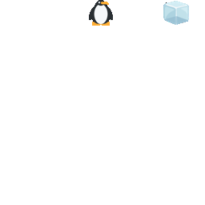
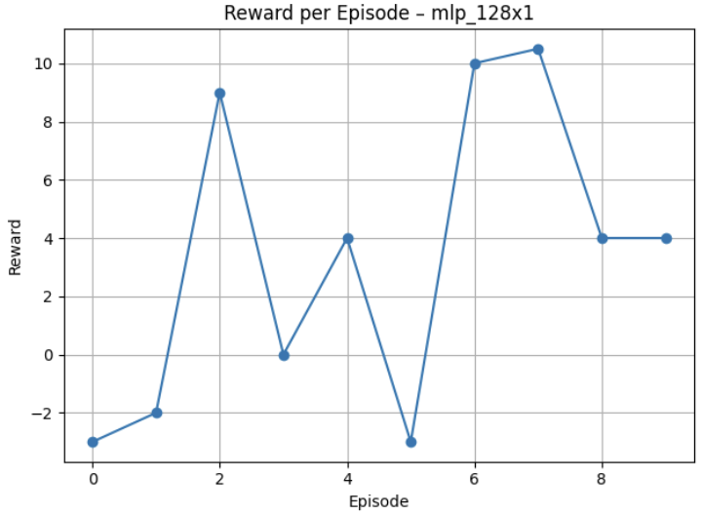
Best Agent Performance and Visual Output
Agent: mlp_128x1
Observations
Reward trend indicates policy convergence across episodes
Color emoji was present in the pool but correctly avoided during placement
Background was rarely selected, limiting maximum reward
Non-deterministic sampling enabled variety, but reduced output consistency
Agent was trained on a fixed 4-role structure (core, 1 modifier, 1 accessory, background) — performance degrades on prompts with different layouts
Total Timesteps: 25000
Training Time: 19 minutes
Mean reward: +3.35
Max reward: +10.5
Most stable convergence with expressive placements
Ç
Example composition with reward: +10.5

Slide 12


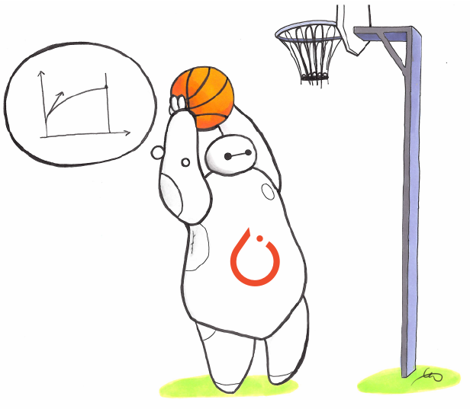




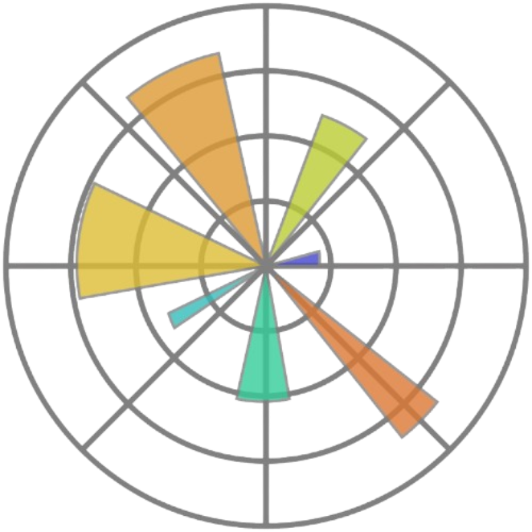



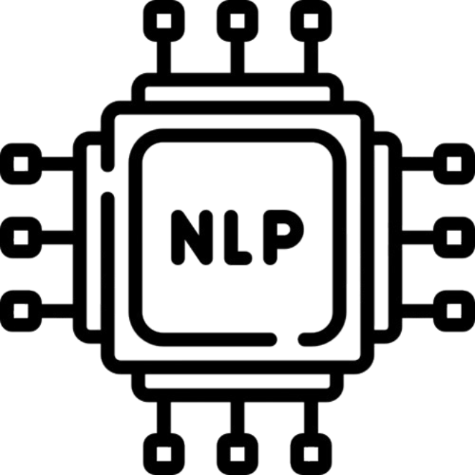

Tools and Libraries Used
Core Libraries
Core Libraries
– Custom RL environment
Stable-Baselines3 – PPO training framework
PyTorch – Underlying neural network engine
Pillow (PIL) – Emoji placement, scaling, and image rendering
OpenCV – Optional image analysis (e.g., cv2.HoughCircles)
NumPy – Math utilities
Matplotlib – Visualization
Tqdm – Progress bars
Data & Resources
emoji_images/ – PNG emoji dataset (from Twemoji GitHub)
emoji_fuzzy_scores.json – Based on tags and descriptions from: “badrex/LLM-generated-emoji-descriptions” (Hugging Face)
Natural Language Processing
– POS tagging and dependency parsing
Custom logic for:
keyword filtering
fuzzy scoring
role mapping
Fuzzy weights and role mapping designed manually

Slide 13




Authorship and Assistance
My Work (fully implemented by me)
All architectural decisions, code integration, and system behavior were designed and implemented specifically for this project.
emoji_generation.py – full genetic algorithm: crossover, mutation, multi-criteria fitness
image_generation.py – Gym-compatible DRL environment (EmojiCompositionEnv)
tokenization.py – custom fuzzy logic parser, role map builder, and score computation
PPO training scripts + evaluation code
Reward function design (written manually, tuned through experimentation)
Fuzzy vector logic (weights and role hierarchy)
Presentation content, analysis, and experimental tuning
Assistance and External Resources
ChatGPT:
Online Resources:
Formatting help, phrasing suggestions, clarifications on PPO mechanics
Help adapting Gym + Stable-Baselines3 integration
Ideas for fuzzy linguistic patterns and evaluation phrasing
SpaCy usage patterns (official docs + community snippets)
Hugging Face emoji metadata (as base for fuzzy score file)
Twemoji PNGs (for emoji rendering)

Slide 14



Summary and Future Work
Project Summary
GenEmoji is a system that translates natural language into emoji compositions
Combines:
All modules were custom-designed and tested for semantic alignment and spatial composition
Fuzzy Logic for interpreting vague linguistic input
Genetic Algorithm for selecting relevant emojis
Deep Reinforcement Learning (PPO) for arranging them on a canvas
Limitations
DRL agent trained on fixed prompt structure (core, modifier, accessory, background)
Color reference logic defined but not fully integrated
Non-deterministic sampling limits reproducibility of final image
No semantic validation for contradictory combinations (e.g., “happy” + “crying”)
Future Improvements
Train DRL agents on variable-length prompts and dynamic role counts
Fully implement emoji coloring and cropping actions
Add a semantic contradiction checker during GA selection
Introduce multi-accessory placement support with intelligent spatial grouping

Slide 15

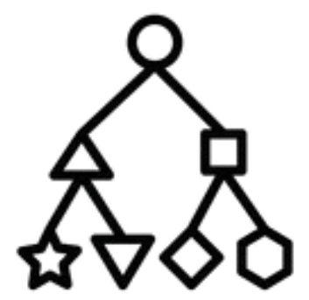


Tools and Libraries Used
Classification
Image Generation
25% Ευστοχία για κατηγοριοποίηση 200 Κλάσεων με χρήση CNN
37% Ευστοχία για Κατηγοριοποίηση 10 Κλάσεων με χρήση SVM
Ολική Απώλεια 0.125
Ψηφία Κατανοητά από Άνθρωπο και Μηχανή
What to improve
Επέκταση των προ-εκπαιδευμένων Δικτύων μέσω Transfer Learning
Πειραματισμός με προηγμένες Τεχνικές Κανονικοποίησης
Επέκταση συνόλων δεδομένων μέσω Ενίσχυσης Εικόνων (Image Augmentation)
Πειραματισμός με διαφορετικές Τεχνικές Μείωσης Διαστάσεων
Χρήση Αρχιτεκτονικής GAN για Παραγωγή Εικόνων
Βελτίωση της ταξινόμησης των τελεστών μέσω βελτιστοποίησης του βάρους απώλειας για κάθε τελεστή

